Slide 1
Mine Holiday
Tomáš podpleský 1.m

Slide 2
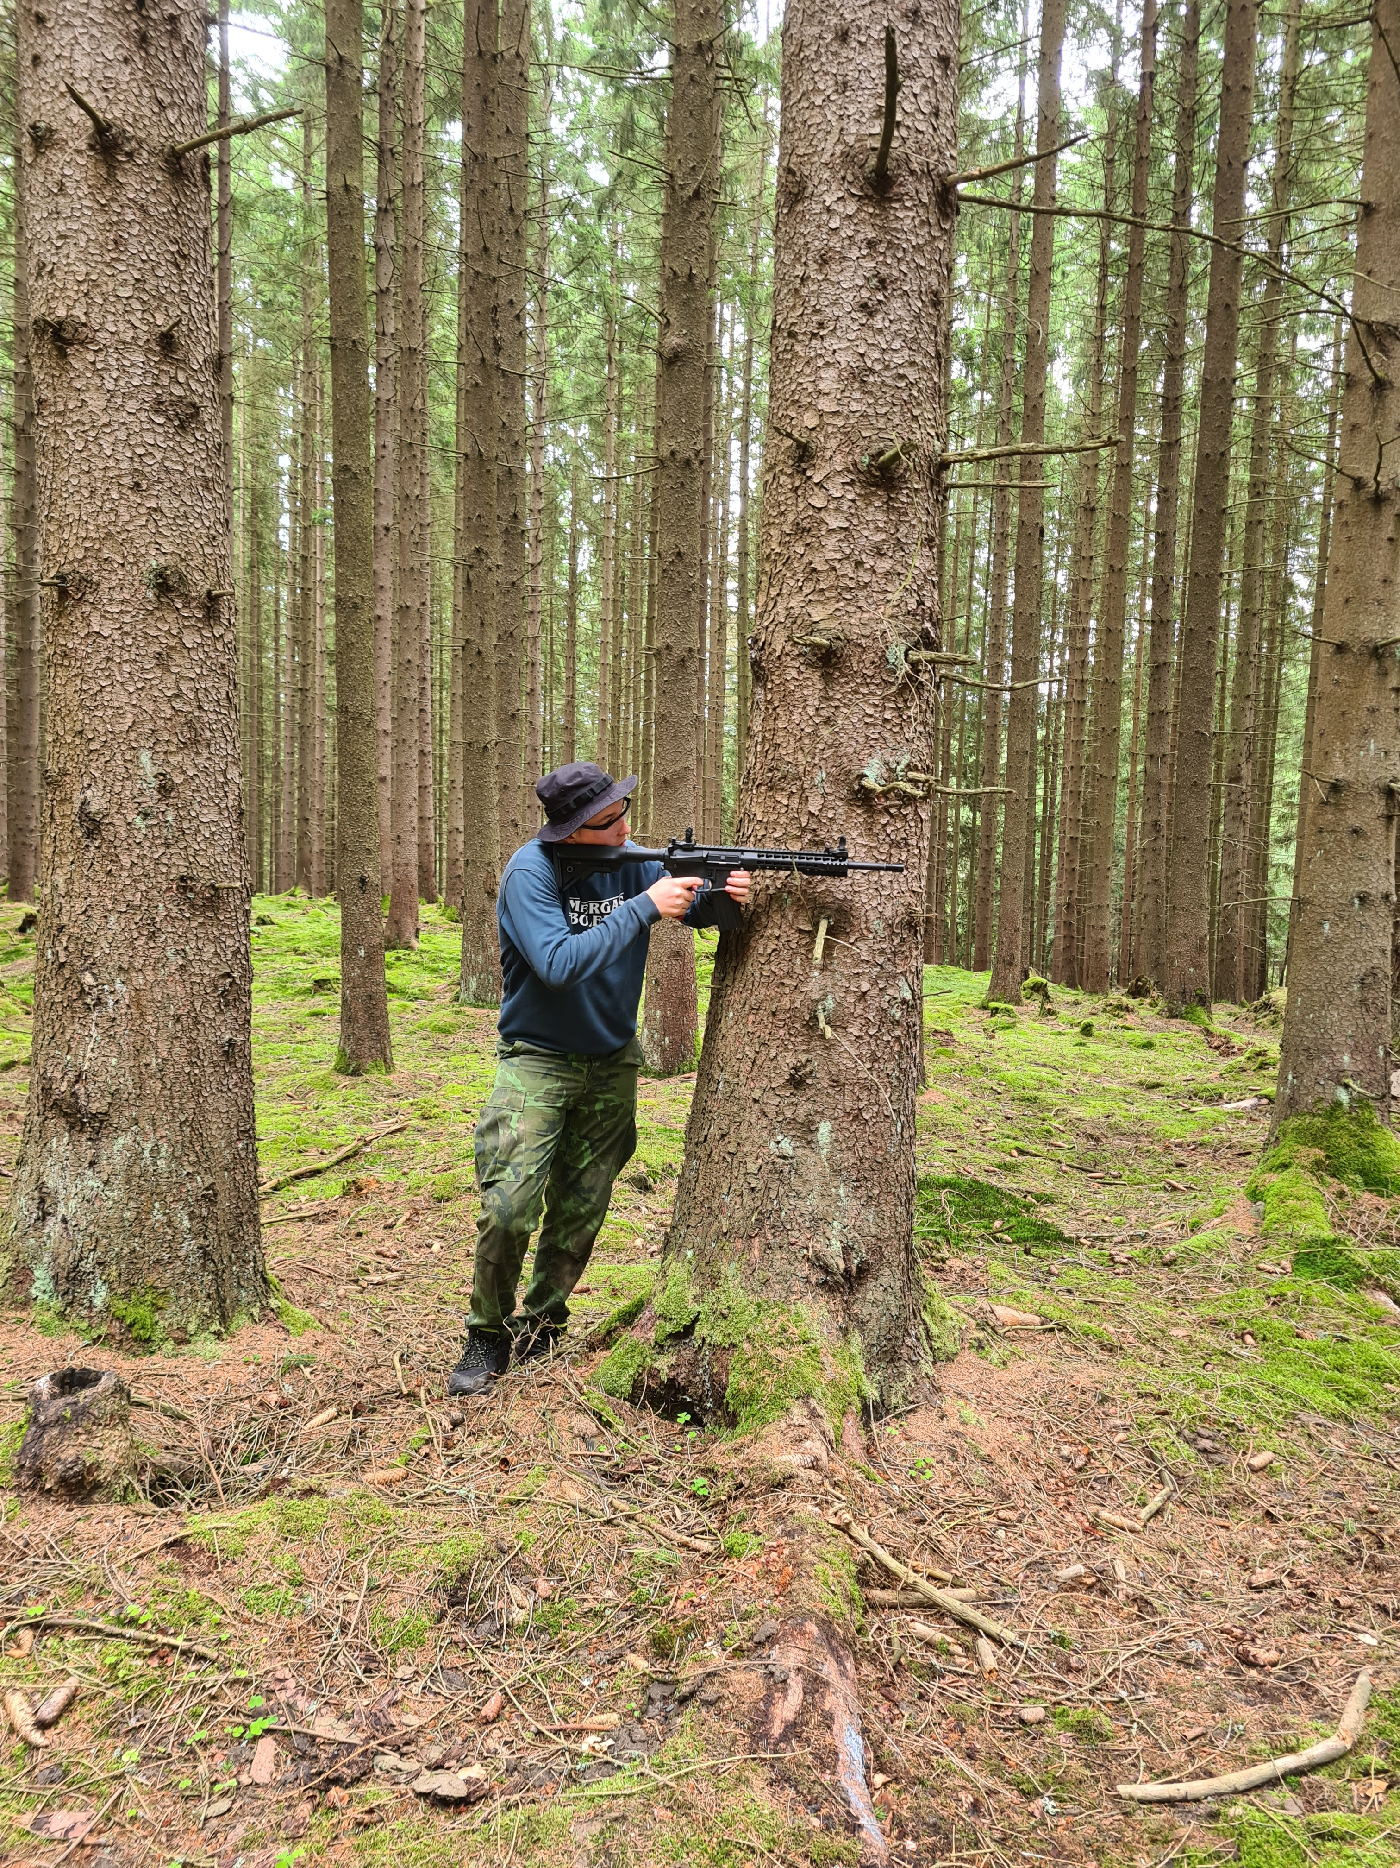
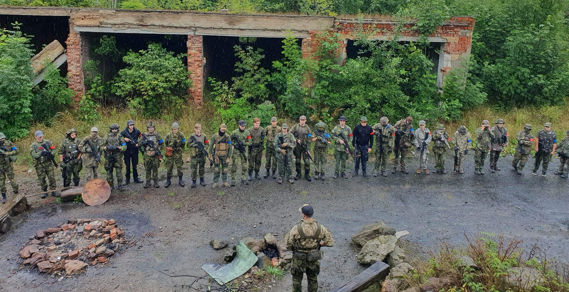
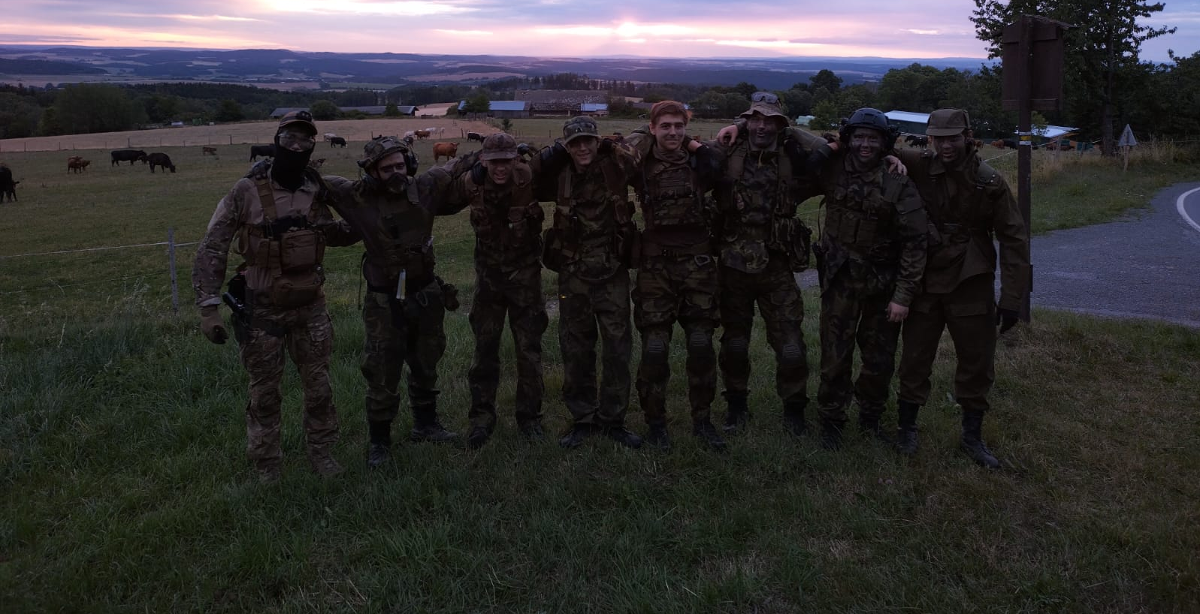
Camp
So, 29th of July, i went on an army/airsoft camp
We played airsoft for a week. We played in the forest, and in a building.
Also, in the night, we got sent to an unknown location and we had to get back to base.

Slide 3
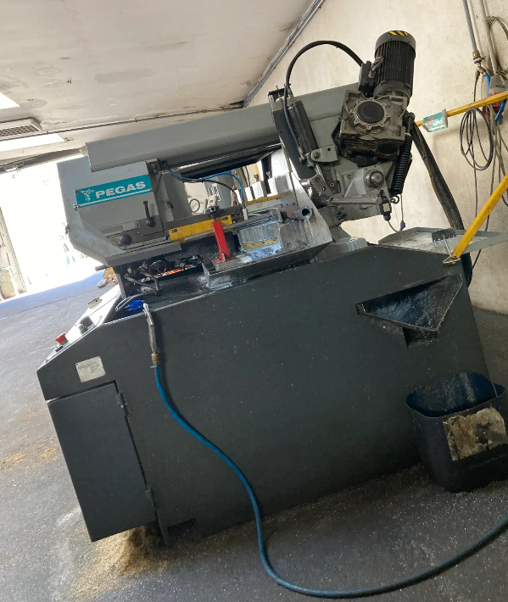
Brigade
I went on a brigade and i worked for one and a half months
I worked in a iron processing company, and i worked on iron saw, and i packed parts

Slide 4
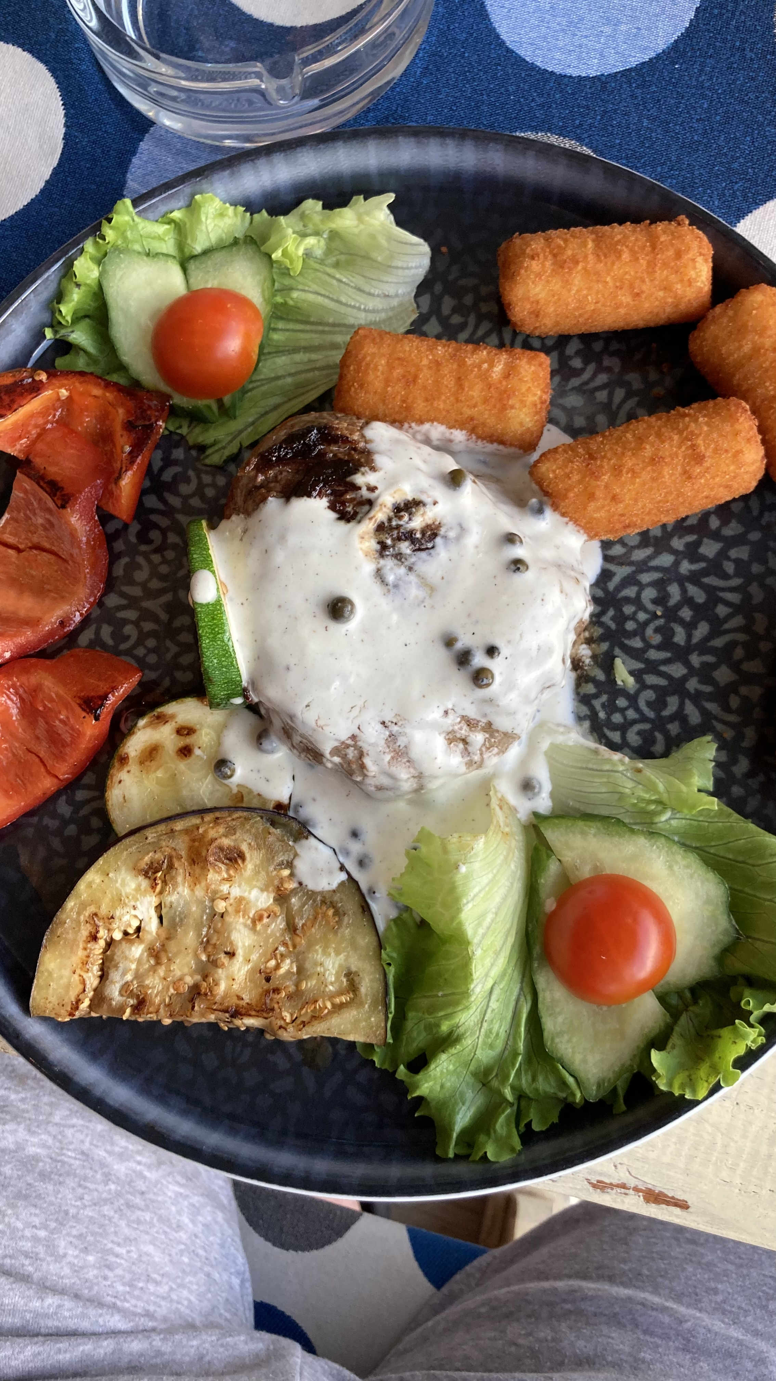
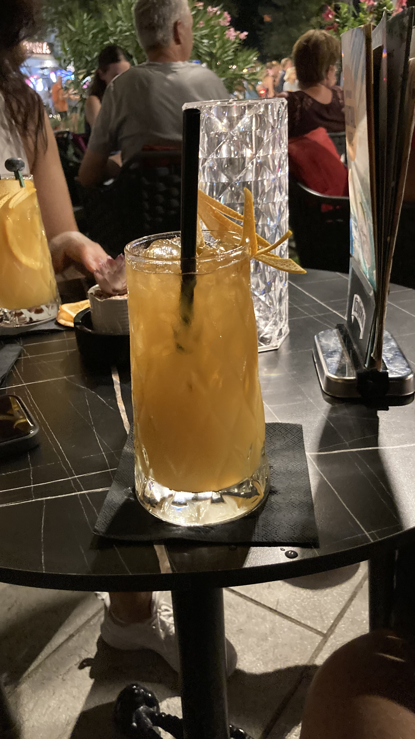
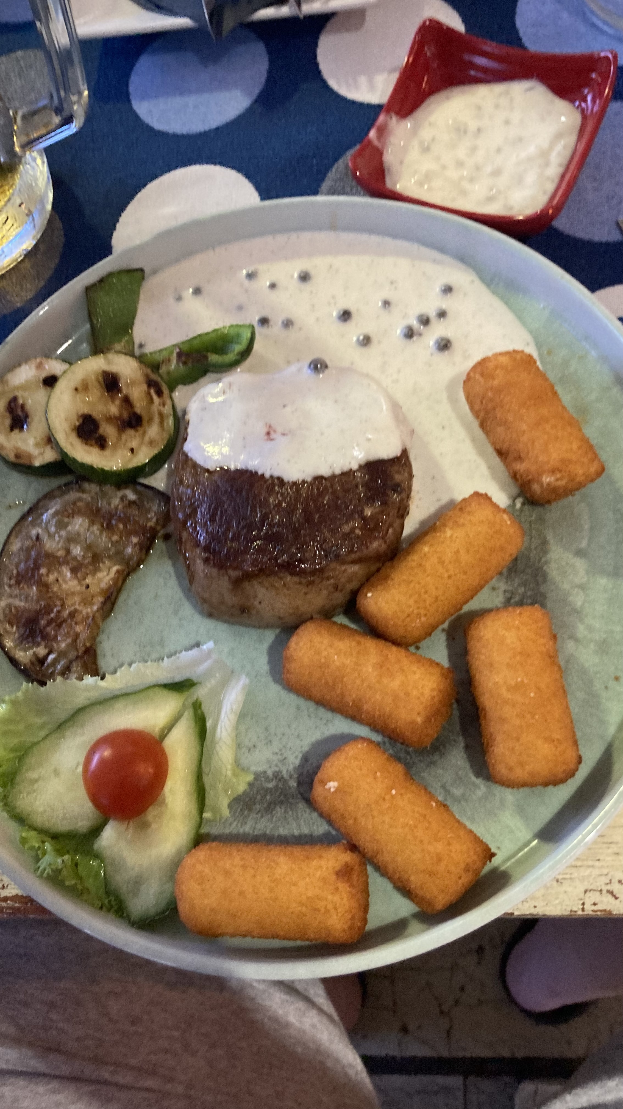
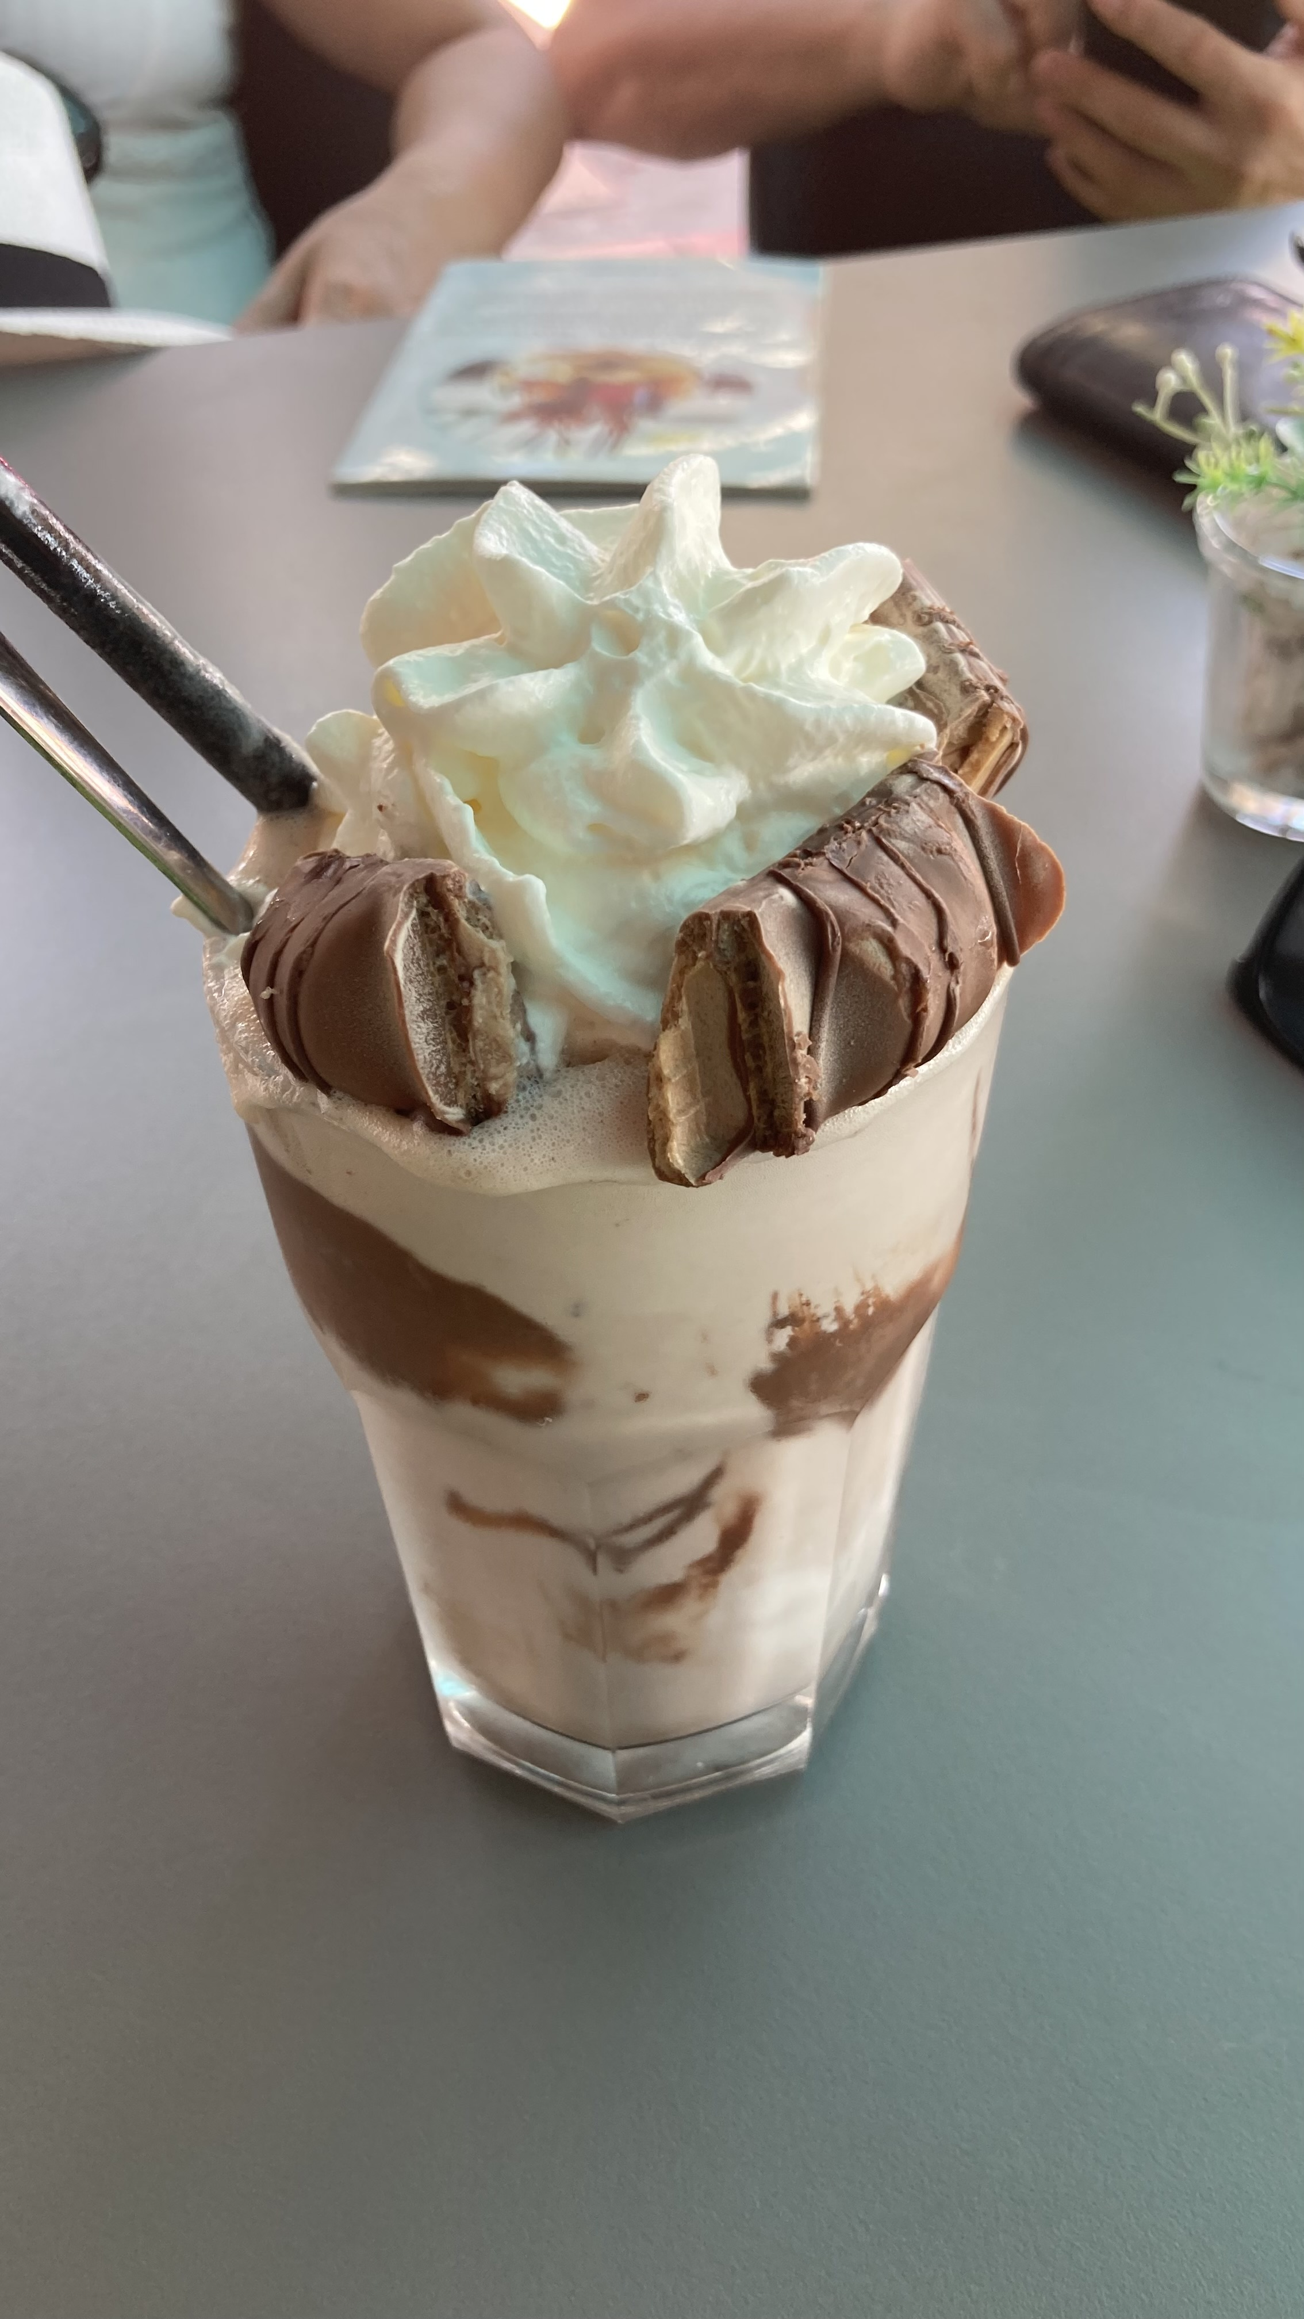
Trip to Crotia
So i went to Crotia with my family
We ate at restaurants and drank drinks at bars
We were there for a week

Slide 5
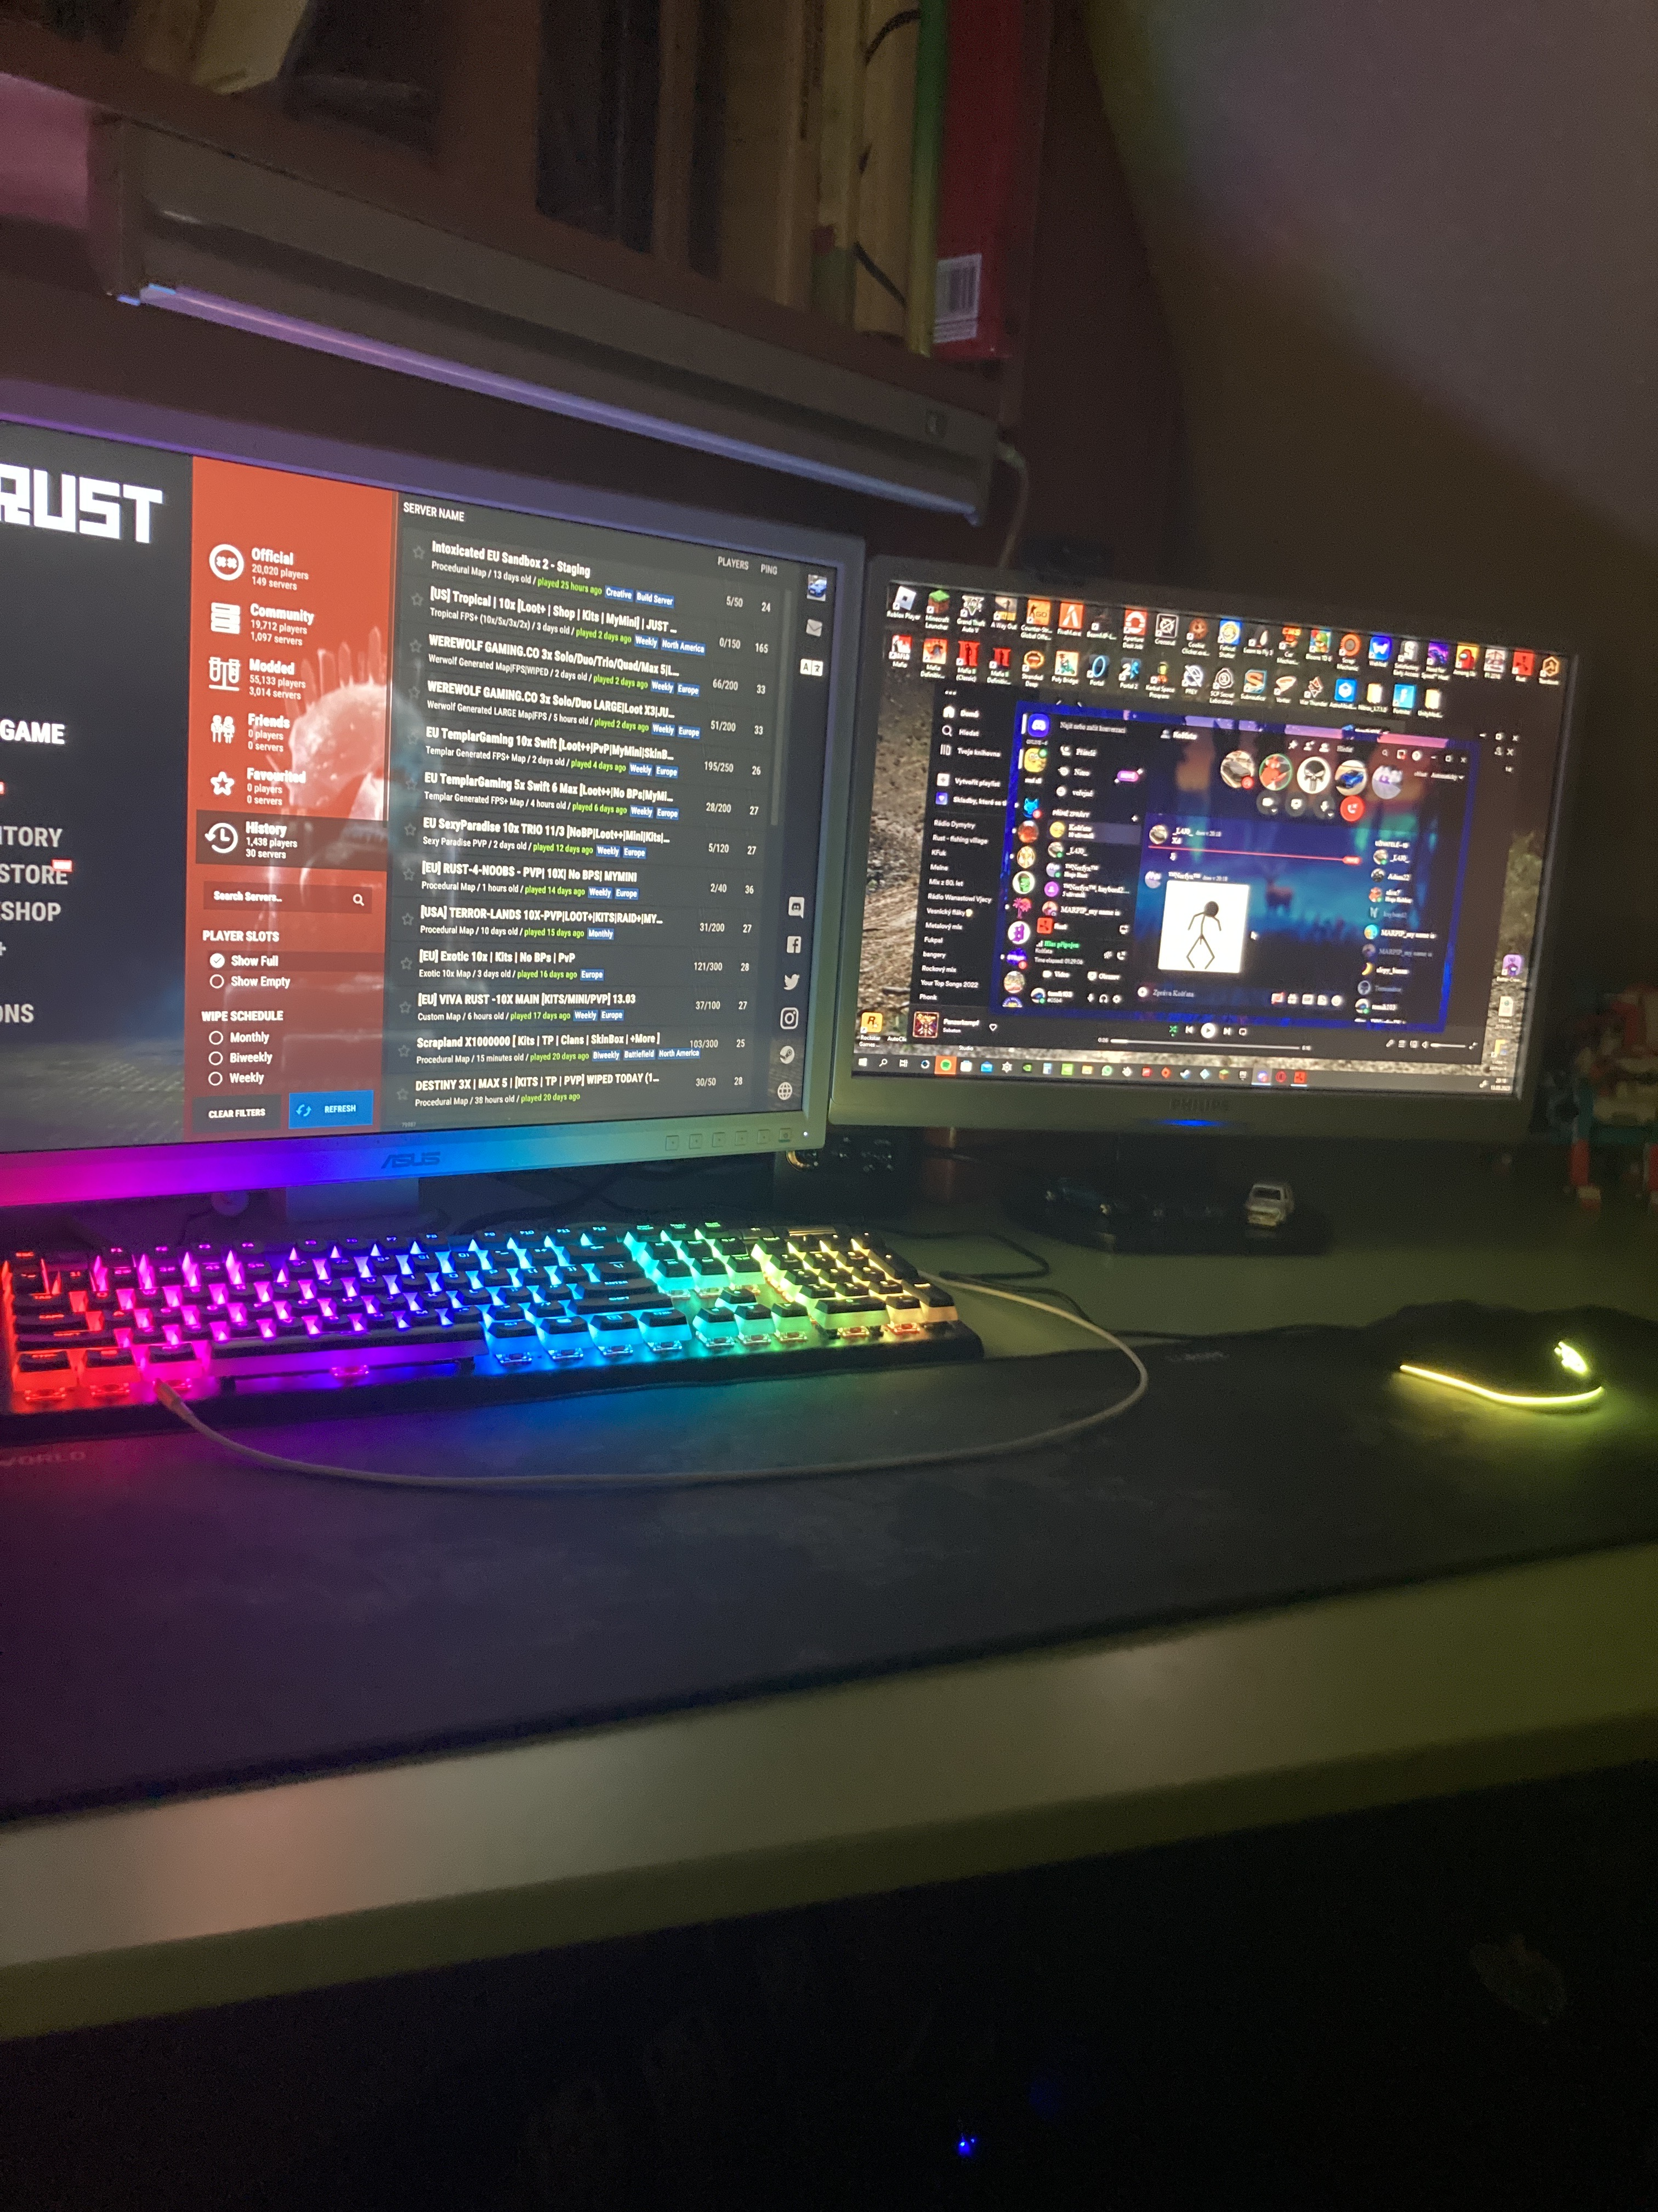
And lastly, i was home and played videogames

Slide 6
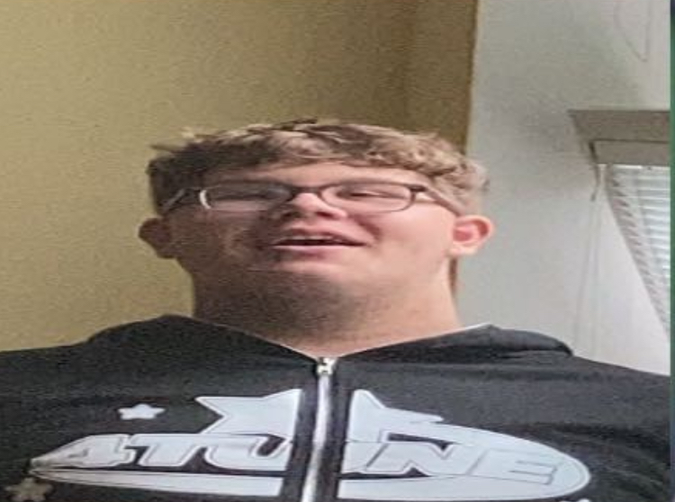
Thank you for your attention

